Slide 1
Re-Inventing the Wheel: The Re-Creation of Documents in a Bumble-Bee Organization
Ingbert Schmidt

Slide 2
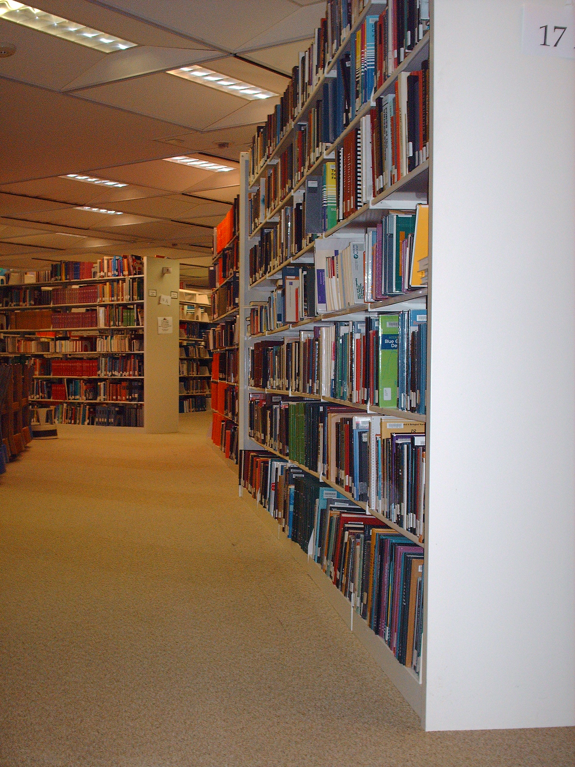
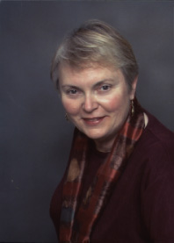
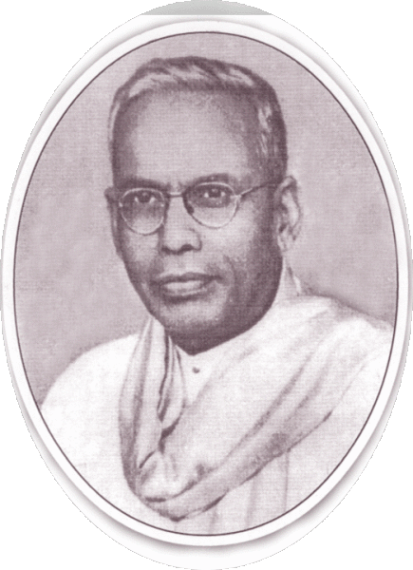
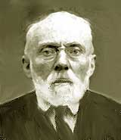
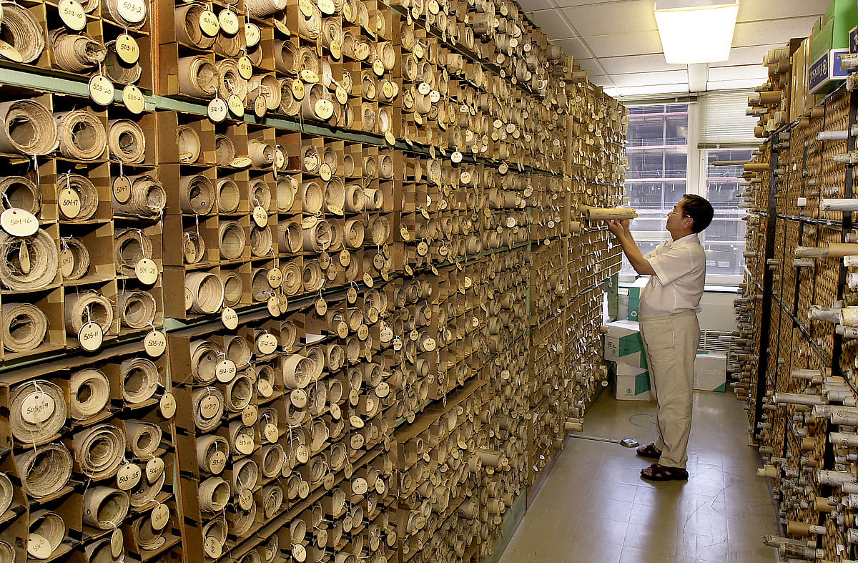
LIS Emphasis: Reuse of Documents
Marcia Bates
S. R. Ranganathan
Paul Otlet
Photo: cybrgrl
Photo: Seattle Municiple Archives

Slide 3
But why use an existing document if you can create one from scratch?
Surprising how often participants created already existing documents from scratch.
Why do they do this?
Empowerment
Learning
Personalization
Customization
Simplification

Slide 4
Research Methods
Methods:
Participant Observation
Interviews
Document Analysis
Ethnographic-like, but not true ethnography
Same diversity of methods, emphasis on Participant Observation
Different goal: to understand the functional how
Not: to understand the human experience (culture)

Slide 5
Researched Graduate Student Union (RGSU)
Union of Graduate Students: ~2700 people, 50-80 active members at any point in time.
Strong commitment to preserving knowledge
Large Archive of documents: 6-8 filing cabinets full; shelves of binders; 40 Gb of files mostly text & images; Google Docs; Dropbox; Mailman Archive
15-20 years worth of documents
Detailed transcription-style minutes taken at many meetings.
Significant amount of time spent saving documents and keeping them accessible

Slide 6
Researched Graduate Student Union (RGSU)
Extremely high turnover:
Members are active 1 year on average
Every year almost completely new leadership
Bargaining Cycle is typically 3 years
Organization is constantly on the verge of falling apart
How-to knowledge and organizational history is constantly being lost
Very minimal training for most activities
Yet is still very successful, AND in the same way as 10 years ago (Tuition Waivers)

Slide 7
RGSU as a Bumblebee Organization
Photo: Dave Young

Slide 8
Preliminary Results: Factors in Favor of Reuse
Time is highly valued
Labor is highly valued
Vast majority of work performed by volunteers
More work than time and energy to do it
Constant transition in people: ~40-70 active members
All are full time students, nearly all are working
Every participant is an expert at using and managing documents

Slide 9
Hidden Benefits of Document Re-Creation
Participants are frustrated that existing documents are constantly being re-created
Participants are constantly trying to develop ways of better making documents accessible
Why does re-creation happen?
Because there are benefits to document re-creation that far outweigh the efficiencies of document re-use.

Slide 10
Empowerment
Extremely important for active members to move from legitimate peripheral participation to centrally active.
Document creation is one such path
Entrusted with labor and ownership over creation leads to sense of ownership/belonging in RGSU
Benefit of empowerment outweighs inefficiency of labor.

Slide 11
Empowerment cont’d
Experienced members will often encourage new members who are excited about (re-)creating a document
Examples: FAQs, Flyers.
Staff and experienced members much less likely to create documents for empowerment
Have much more re-use because have already experienced the creation of documents.

Slide 12
Learning
The act of re-creating a document often serves as a learning opportunity.
Can be a form of teaching (Grzega 2006)
Can be a form of learning by doing
“Don't Reinvent The Wheel, Unless You Plan on Learning More About Wheels” – Jeff Atwood

Slide 13
Learning: Example – Guide to Running Department Meetings
At least three guides, DM1, DM2, DM3, created by 3 different people, M1, M2, M3
M2 created her guide to capture her experience running department meetings in many different departments
Created 5+ page guide with many details
M3 knew about DM2, but without looking at it created DM3 to capture her experience trying to encourage people to do department meetings.
Created 1 page guide with minimal details

Slide 14
Personalization
Personal touch is a way of taking ownership over document, and it takes many forms.
Personalization makes the document special in a way that distinguishes it from other versions.
Personalization is not sufficient alone as a reason to re-create a document, but can be a powerful contributing factor to the decision.
Lightest form is a personal style, vocabulary, or in-joke.

Slide 15
Personalization cont’d
Deeper form is an intensely personal experience embodied in the document.
Strike Reflection, strategic plans
Department Meeting Guides
Forms can range significantly.

Slide 16
Customization
RGSU is in a constantly changing environment, needs to be responsive to current situation.
One of the benefits of document re-creation is that the produced documents are produced for the moment.
For example, DM2 was created specifically for the situation of getting lots of departments that were very different in nature to run meetings, so incorporated flexibility and principles.

Slide 17
Customization cont’d
DM3 was created at a time when lots of people wanted to run department meetings, but were worried that it might be too hard, too time consuming, so focused on how simple a meeting could be.
Both were created to be general purpose documents, but their contextual customization made them especially useful.
Neither has seen long-term adoption.

Slide 18
Simplification
Empowerment and Learning can be sufficient to motivate document re-creation.
Personalization and Customization often contribute to the motivation.
Most often the initial push to document re-creation is that it is simpler to create the document anew than to find it in the archive.
Well known fact, so I will just review factors relevant to the RGSU.

Slide 19
Simplification: Motivations in the RGSU
RGSU Archive split over many media: Paper, multiple file systems on different computers, Dropbox & Google Docs, email archives.
Access—not everybody has it.
Multiple locations where a particular document might live – despite frequent reorganization.
Lack of knowledge of what is in the filing system.
Participants do not think to look.

Slide 20
Other Findings
Conversation Enabler
Documents that do not stand alone very well
Vital for facilitating F2F conversation
Extremely popular – mostly by experienced people
Knowledge contained within people (Myth of Paperless Office)
Few Documents are reused
Those that are – reused socially (Bargaining), when reused effectively (exception: Grievance)
Suggests that the way to move forward is focusing on work and work needs, rather than documents and document structures.

Slide 21
Implications
Reflections documents remain largely unread unless there is practically no organizational memory.
Document Salience: make documents that are likely to be reused easier to find.
Organization: by task instead of by date

Slide 22
Example

Slide 23
Conclusions
Empowerment transitions members from being legitimate peripheral participants to centrally active members.
Learning allows members to reflect on their experience and capture it for others.
Personalization is important to help motivate volunteers to get the work done.
Customization allows the created documents to be more relevant to the current situation.
Simplification? Sometimes it is just too much of a pain to find the darn thing.
Questions?

